Slide 1


Bioinformatics Summer School
Long-reads Transcriptomics
Yalan Bi & Fabian Jetzinger
Max Plank Institute, Berlin, Germany BioBam Bioinformatics, Valencia, Spain
LongTREC - The Long-reads TRanscriptome European Consortium
Marie Skłodowska-Curie grant agreement No 101072892

Slide 2
Course Contents
1
Challenges in transcript identification
2
Landscape of bioinformatic tools

Slide 3
Section 1
Challenges in transcript identification
Understanding the complexity of transcript identification and quantification

Slide 4
Disambiguation
Long-read RNAseq data sets contain millions of reads
Millions of reads, many minor differences
Goal: collapse similar reads to identify consistently occurring transcript models
Identify known (annotated) and novel transcripts
Many different terms for this process
Transcript | Isoform identification | discovery
Transcriptome reconstruction
Transcript(ome) assembly (holdover from short reads)

Slide 5
Challenges in transcript identification
Long-read RNAseq data poses many challenges
Sequencing quality and depth
Biases (e.g. towards sequencing shorter molecules, higher GC content, etc.)
Mapping inaccuracies (e.g. micro-exons)
Incomplete reads
Transcript divergency (minor inconsistent variations in splicing)
Goal: differentiating biological and technical artifacts from real transcripts

Slide 6
Section 2
Landscape of bioinformatic tools
Understanding strategies for transcript identification and quantification

Slide 7
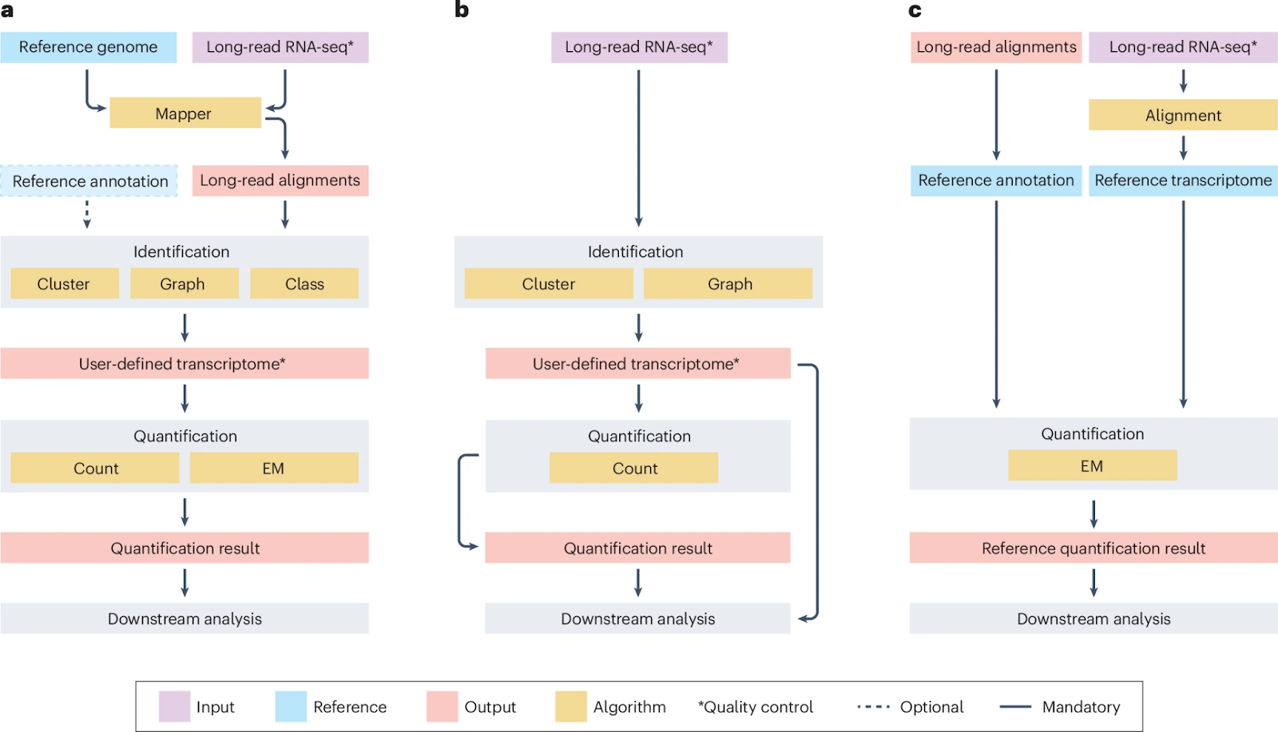
Isoform identification and quantification strategies
Reference-guided
Reference-guided
Reference-free (de novo)
Direct quantification
Identify isoforms based on:
Reference genome
Reference annotation
IsoTools, IsoQuant, FLAIR, Bambu, etc.
Reference-free
Without any reference information
isON-pipeline, RNA-Bloom2, RATTLE, etc.
Direct quantification
No discovery of novel isoforms
Oarfish, lr-kallisto, LIQA, Nanocount, etc.
Diagram: Monzó C, Liu T, Conesa A. Transcriptomics in the era of long-read sequencing. Nat Rev Genet. 2025 Mar 28. doi: 10.1038/s41576-025-00828-z. Epub ahead of print. PMID: 40155769.

Slide 8
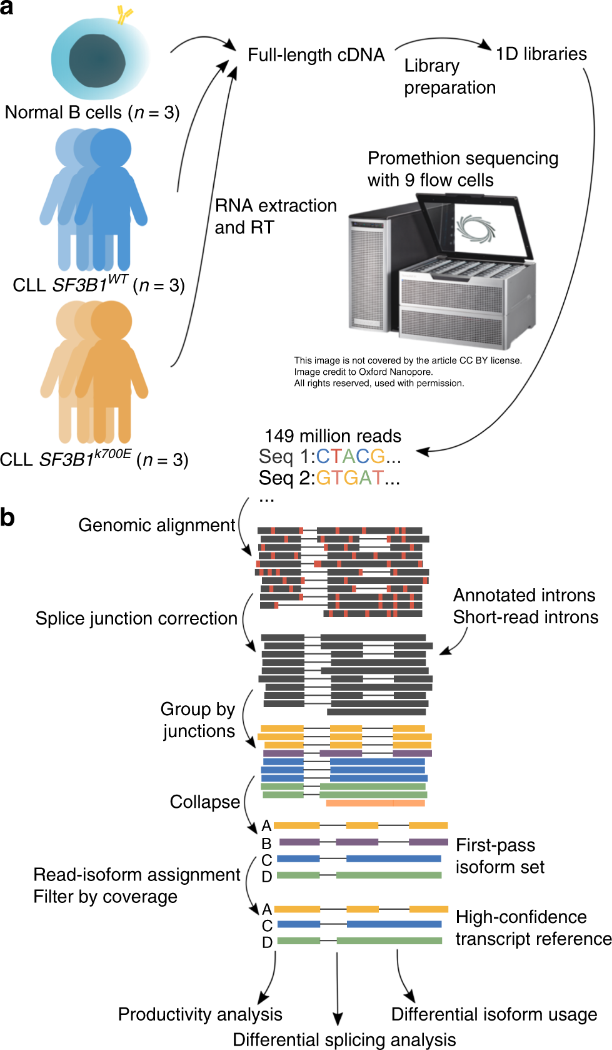




Reference-guided strategies
Alignment to reference genome
Flair
Cluster-based:
Transcriptome reconstruction
Group by splice junctions
Collapse
Figure modified from Flair paper.
Flair: Tang, Alison D et al. Nature communications vol. 11,1 1438. 18 Mar. 2020, doi:10.1038/s41467-020-15171-6
Flair2: Tang, Alison D et al. Genome biology vol. 25,1 173. 2 Jul. 2024, doi:10.1186/s13059-024-03301-y

Slide 9
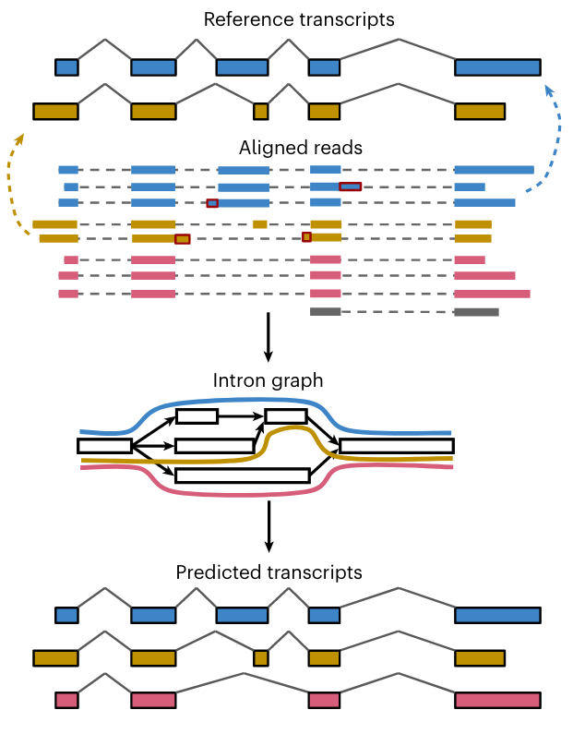
Reference-guided strategies
Alignment to reference genome
IsoQuant
Graph-based:
Transcriptome reconstruction
Create intron graph
Predict from paths
Figure modified from IsoQuant paper.
Prjibelski, Andrey D et al. Nature biotechnology vol. 41,7 (2023): 915-918. doi:10.1038/s41587-022-01565-y

Slide 10
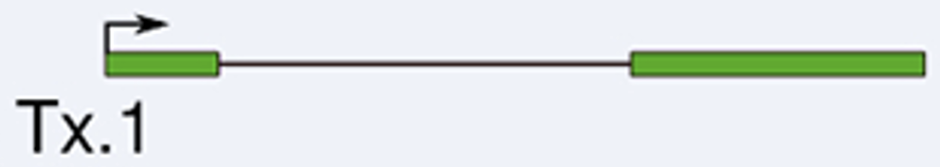

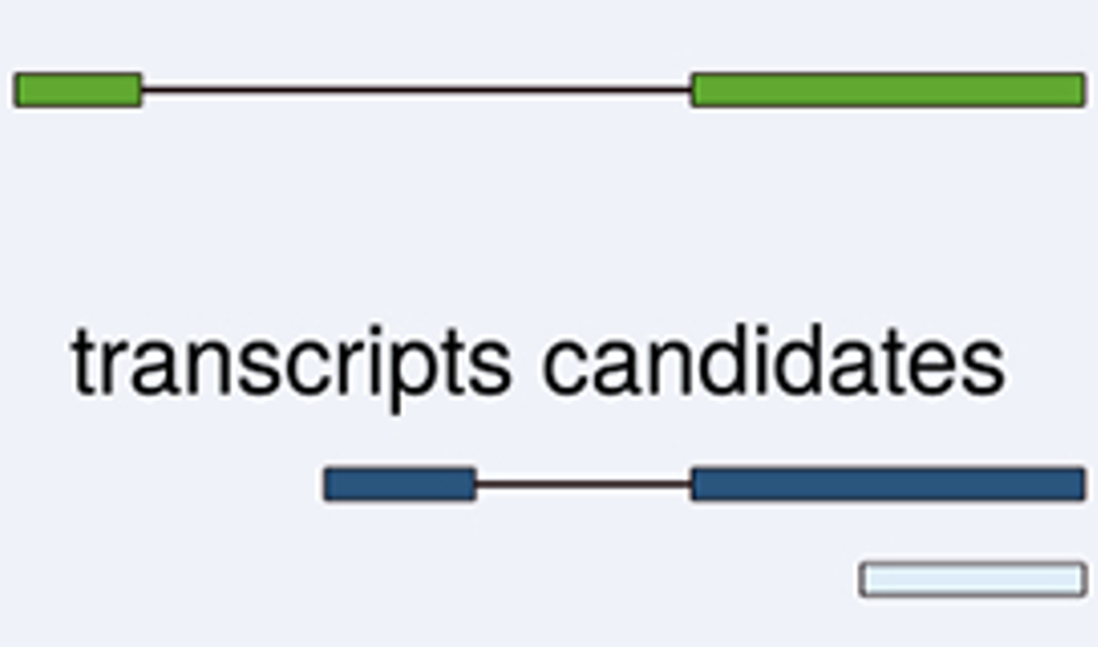
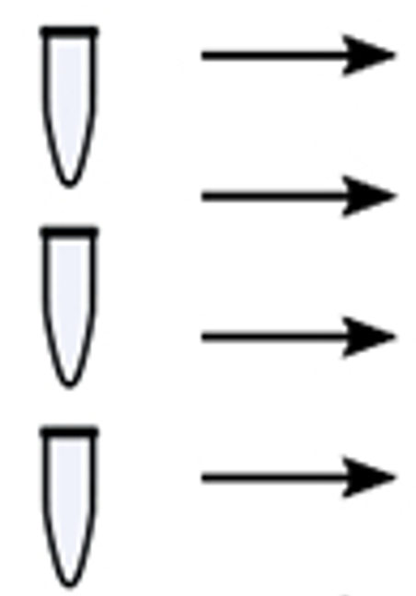
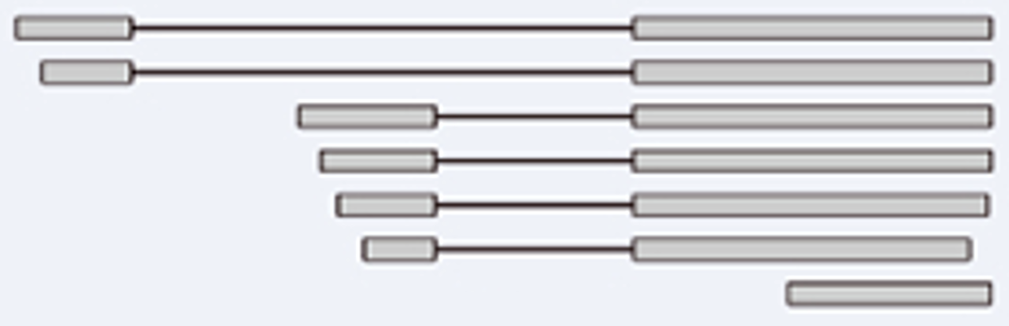
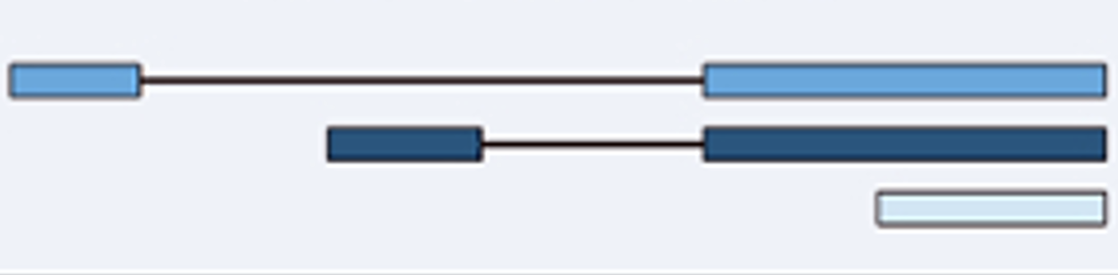
Reference-guided strategies
Alignment to reference genome
Bambu
Class-based:
(context-aware)
reference annotations
Transcriptome reconstruction
Estimate transcript probability score (TPS)
reads
reference transcripts
Novel discovery rate (NDR)
transcript candidates
read classes
Figure modified from Bambu paper.

Slide 11
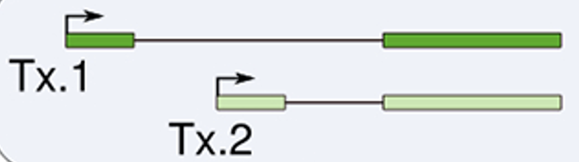
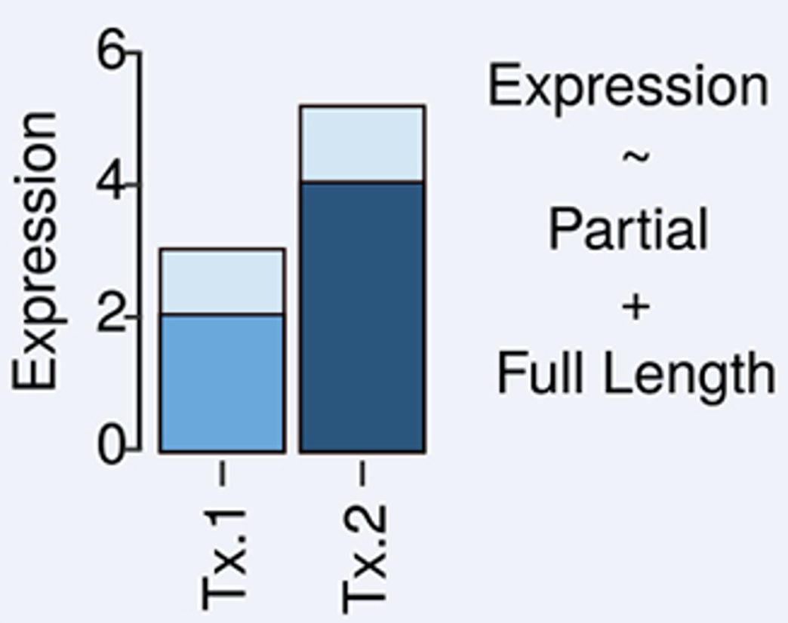
Reference-guided strategies
Alignment to reference genome
Bambu
Class-based:
context-aware
reference annotations
Transcriptome reconstruction
Expectation-Maximization (EM) algorithm
reference transcripts
full-length
partial-length
EM
transcript candidates
read classes
Figure modified from Bambu paper.
Chen, Ying et al. Nature methods vol. 20,8 (2023): 1187-1195. doi:10.1038/s41592-023-01908-w

Slide 12
Reference-guided strategies
Alignment to reference genome
Transcriptome reconstruction
All the transcript models inferred from reads
Quality control
Quantification

Slide 13
Isoform identification and quantification strategies
Reference-guided
Reference-guided
Reference-free (de novo)
Direct quantification
Identify isoforms based on:
Reference genome
Reference annotation
IsoTools, IsoQuant, FLAIR, Bambu, etc.
Reference-free
Without any reference information
isON-pipeline, RNA-Bloom2, RATTLE, etc.
Direct quantification
No discovery of novel isoforms
Oarfish, lr-kallisto, LIQA, Nanocount, etc.
Diagram: Monzó C, Liu T, Conesa A. Transcriptomics in the era of long-read sequencing. Nat Rev Genet. 2025 Mar 28. doi: 10.1038/s41576-025-00828-z. Epub ahead of print. PMID: 40155769.

Slide 14
LRGASP – one benchmark to rule them all
Challenge 1: Reference-guided isoform identification
Challenge 2: Quantification
Challenge 3: Reference-free isoform identification
Final recommendations
Prefer sequence quality for isoform identification and sequencing depth for quantification
To study known isoforms: Bambu, IsoQuant, FLAIR
To study rare, novel isoforms: include orthogonal short reads with FLAIR, Mandalorion
Quantification: IsoQuant, FLAIR, Bambu
To create reference annotations: high-quality data, replicates, orthogonal data, multiple tools
Pardo-Palacios, F.J., Wang, D., Reese, F. et al. Systematic assessment of long-read RNA-seq methods for transcript identification and quantification. Nat Methods 21, 1349–1363 (2024). https://doi.org/10.1038/s41592-024-02298-3

Slide 15
Reflection
In the following situations, which challenges do you face, and which type of tool would you choose?
Reminder of challenges: Sequencing quality and depth, biases (e.g. length), mapping inaccuracies, incomplete reads, transcript divergency
Reminder of tool options: 1. Transcriptome reconstruction reliant on reference genome (and annotation) 2. De novo transcriptome reconstruction without any reference information
3. Reference-based quantification only (without transcriptome reconstruction)
You have lrRNA-seq data of an organism that has not been sequenced before.
You have lrRNA-seq data of a model organism but are not interested in discovering novel isoforms.
You have lrRNA-seq data of a model organism and are interested in condition-specific (e.g. disease) differences in alternative splicing, including novel isoforms.
You have lrRNA-seq data of an organism with a relatively reliable reference genome, but no good reference annotations.

Slide 16


Questions?
For more information about the LongTREC Summer School:
https://longtrec.eu

Slide 17
Thank You!
For more information about the LongTREC Summer School:
https://longtrec.eu

